Slide 1
8TH GRADE TRIP TO WASHINGTON, DC

Slide 2
WHY EJRP?
Serve mission areas of providing recreational experiences and diverse learning opportunities
Meet community need/desire for programming
Familiar connection with kids and families
Open to all, affordable, high quality
Continuity for future 8th graders
Community-wide fundraising opportunities
Scholarships opportunities

Slide 3
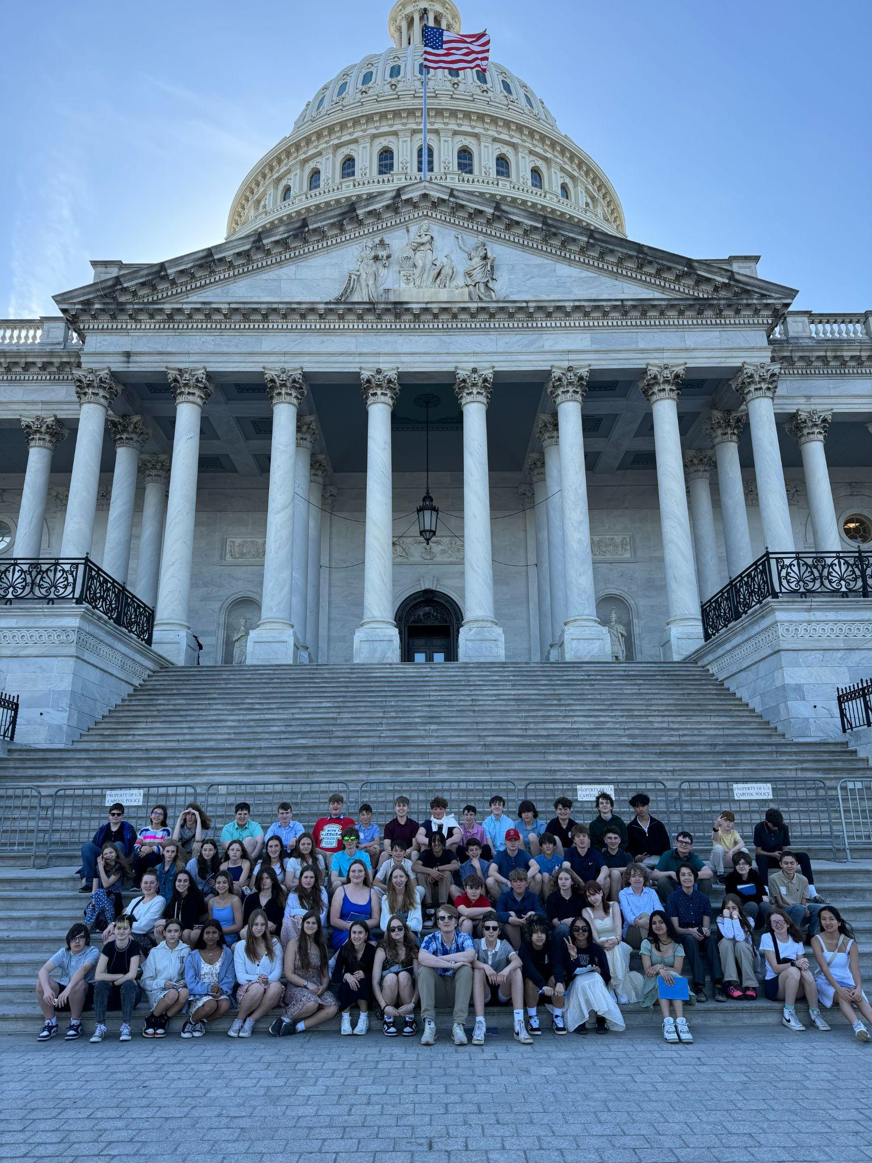
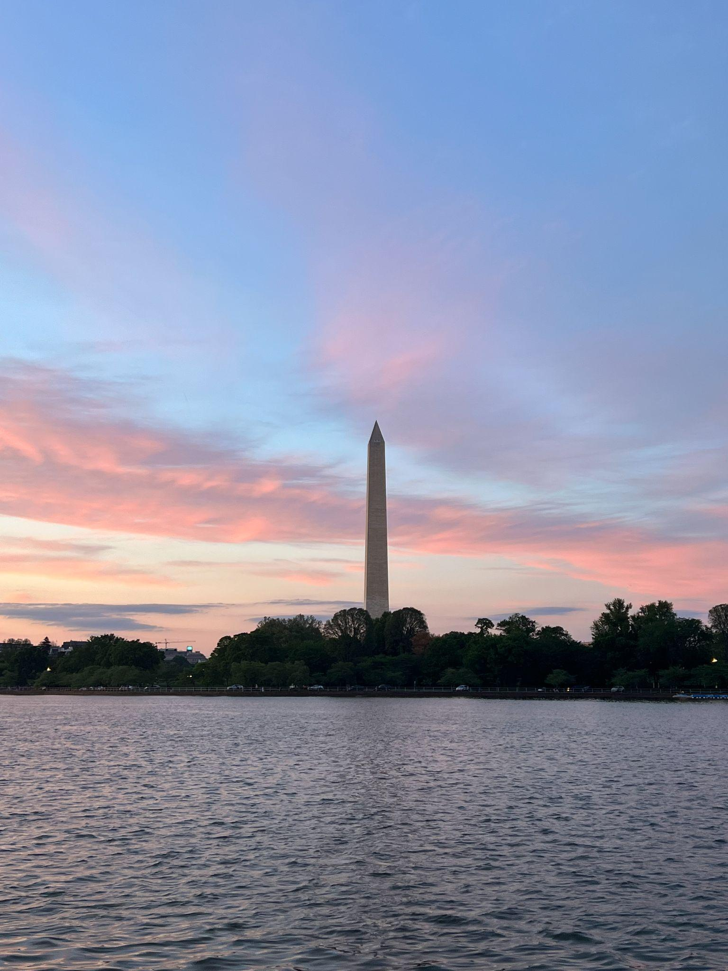
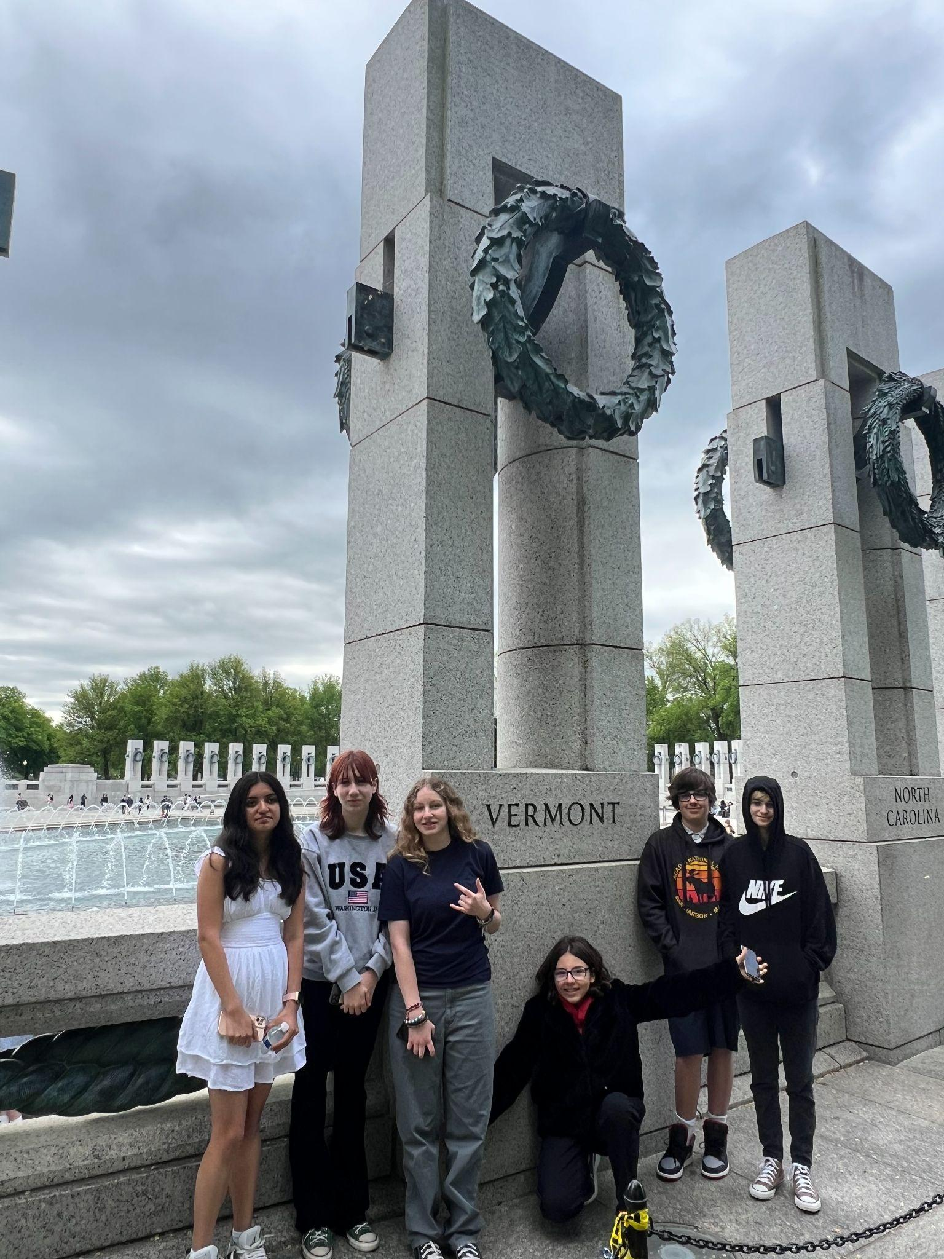
WHO CAN GO?
All 8th grade students that attend Albert D. Lawton Intermediate School or live in the City of Essex Junction

Slide 4
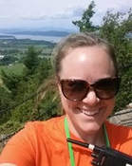
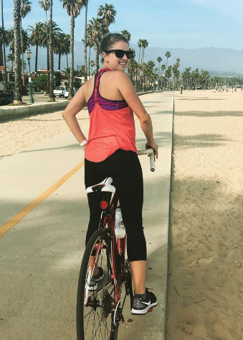
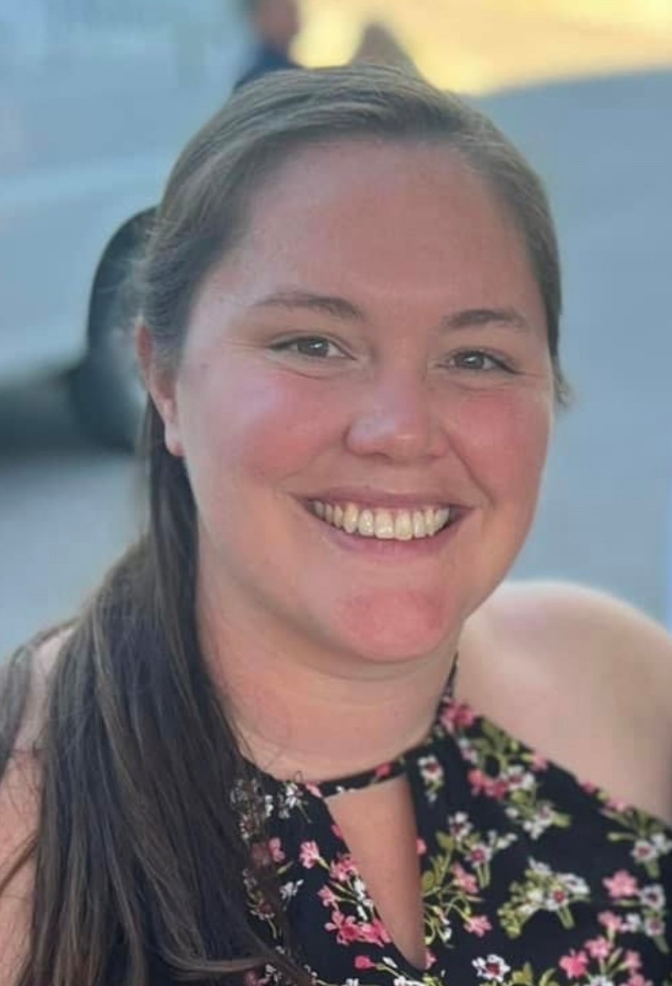
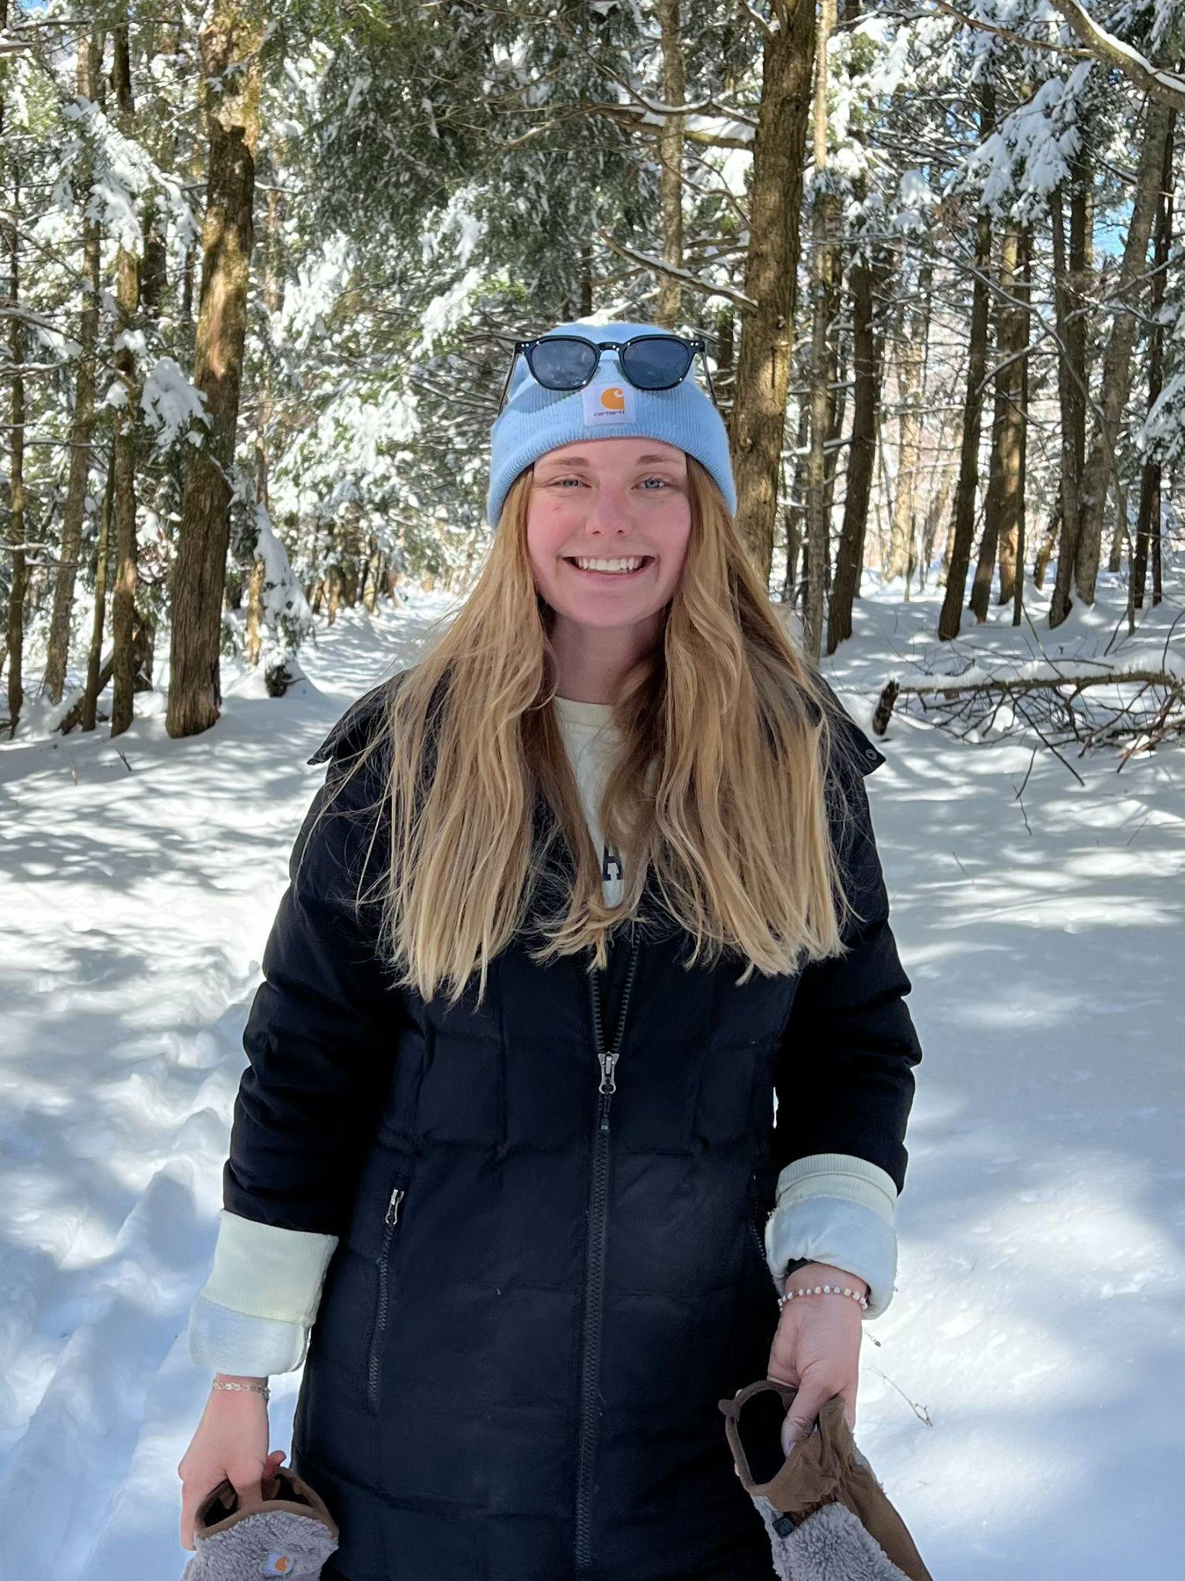
CHAPERONES
This is a list of last years chaperones. We typically have 6-8 EJRP employees come on the trip.We will have a definitive list by the pre-trip meeting in April.
Maureen Gillard, School Age Childcare Director, EJRP
(DC Chaperone 2017, 2018, 2019, 2022, 2023, 2024)
Rosy Gallo, School Age Childcare Director, EJRP
(DC Chaperone 2019, 2022, 2023,2024)
Alyssa Callan, Licensed Childcare Administrator
(DC Chaperone 2019, 2023, 2024)
Cass Falone, Assistant Childcare Director, EJRP
(DC Chaperone 2024)

Slide 5
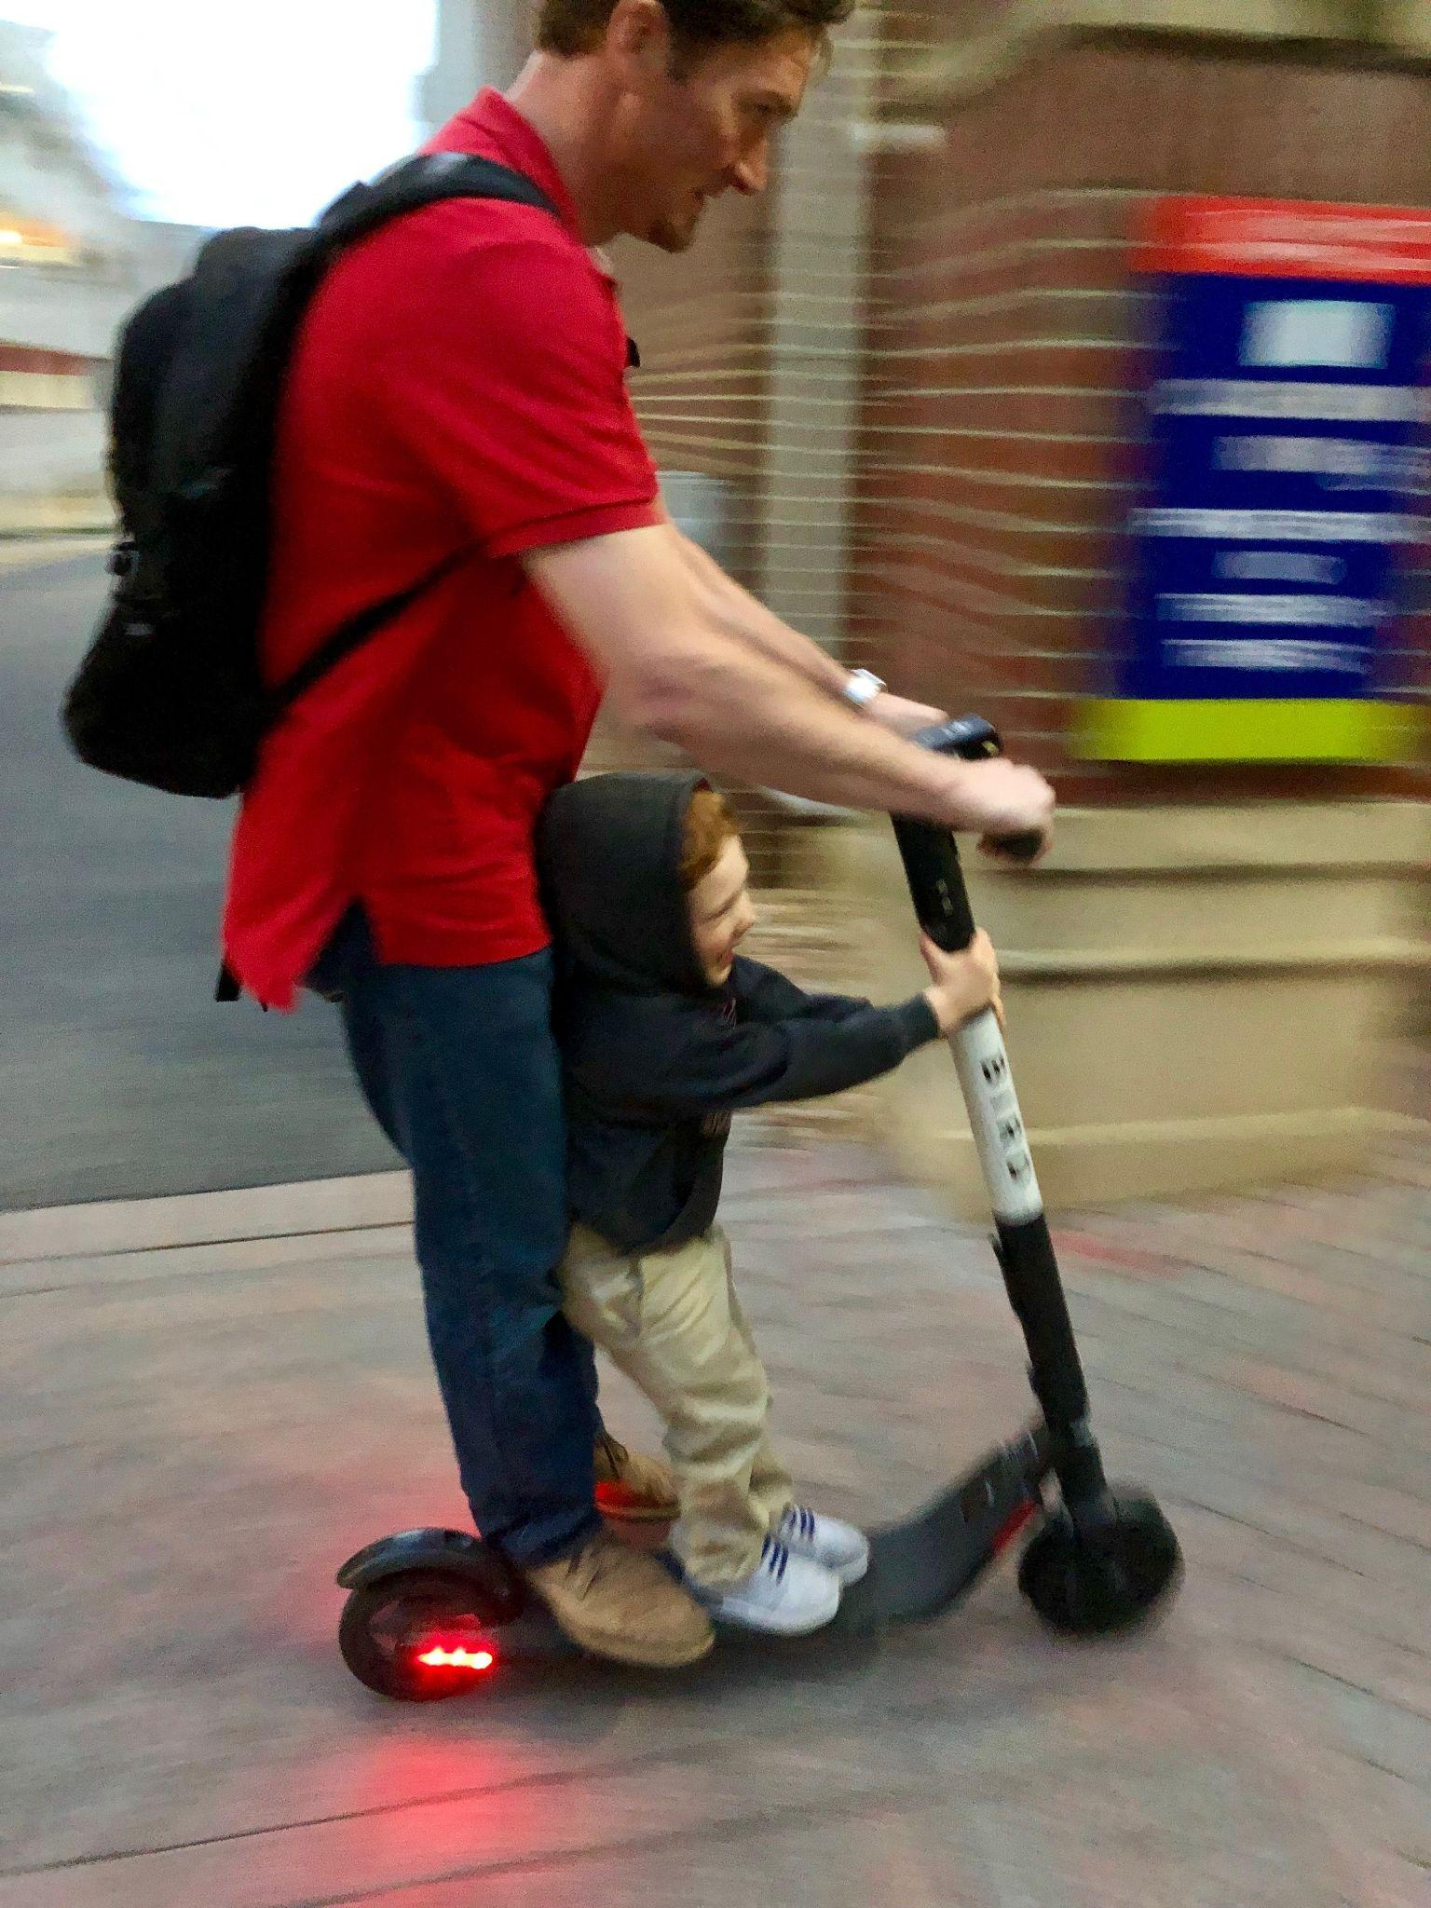
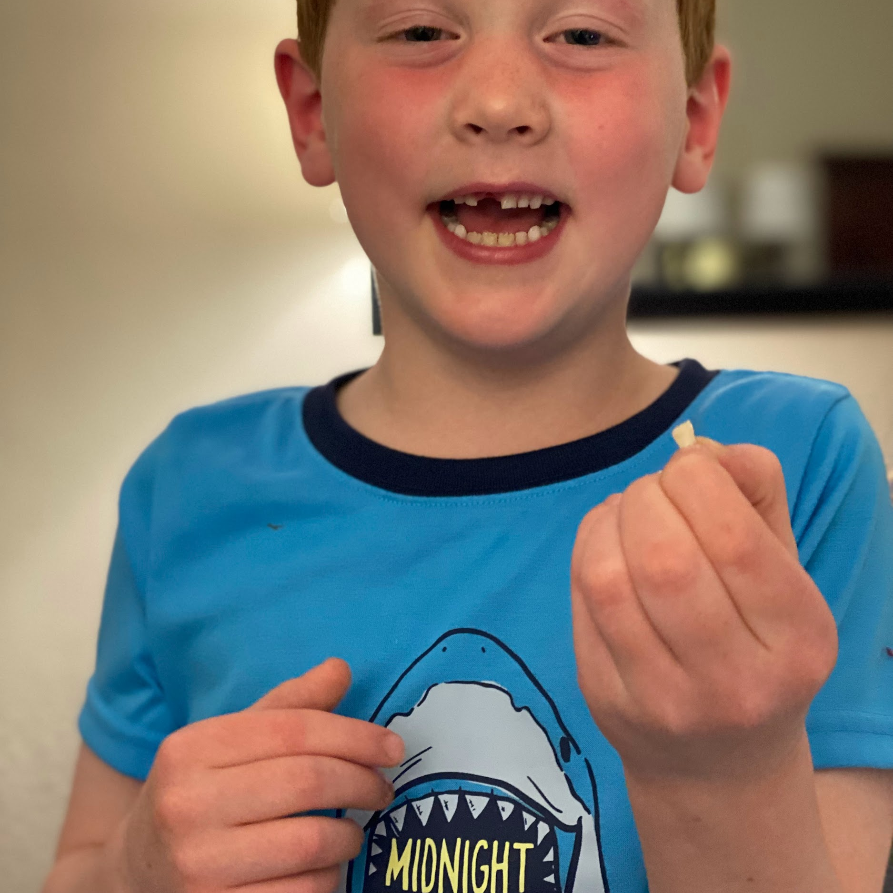
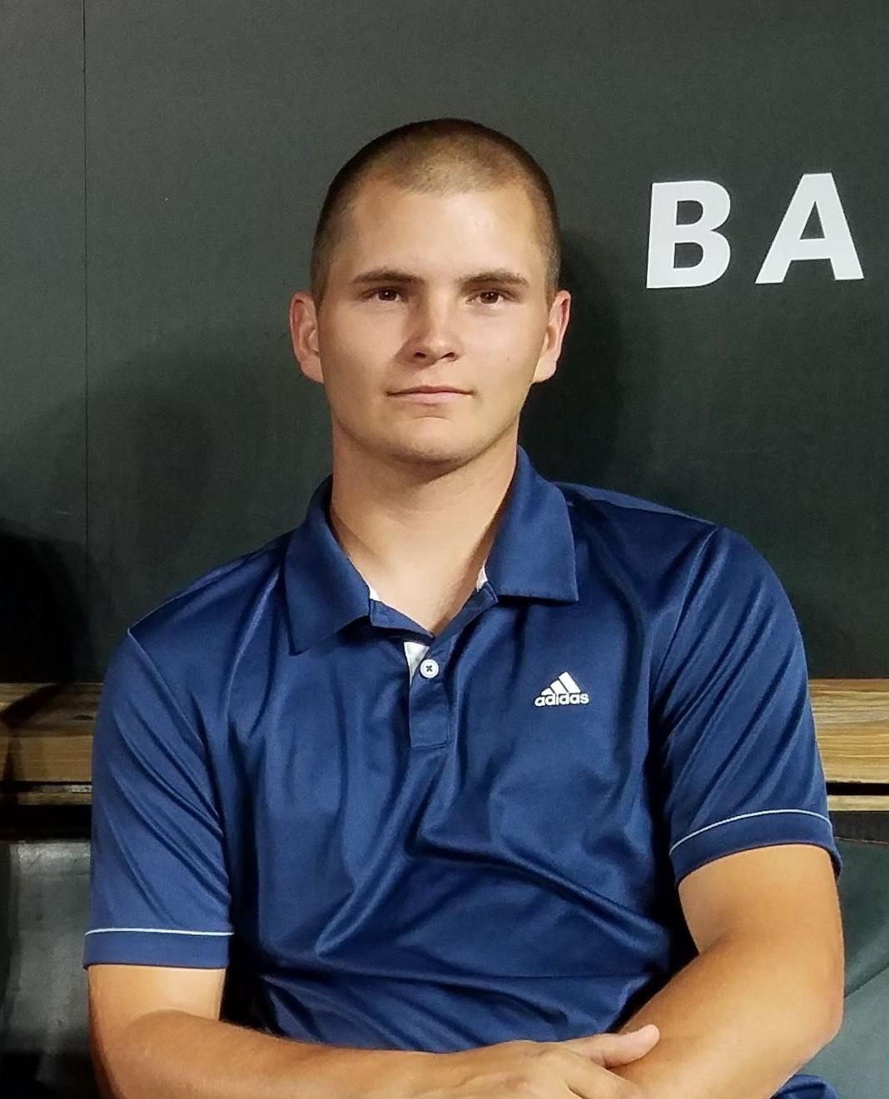
CHAPERONES
Brad Luck, Director, EJRP
(DC Chaperone 2015, 2016, 2018, 2019, 2022, 2023, 2024)
& Graham Luck (DC 2019, 2022, 2023,2024)
Lindsey Massucco, Program Director, EJRP
(DC Chaperone 2023, 2024)
Matt Smith, Grounds & Facilities Foreman, EJRP
(DC Chaperone 2024)

Slide 6
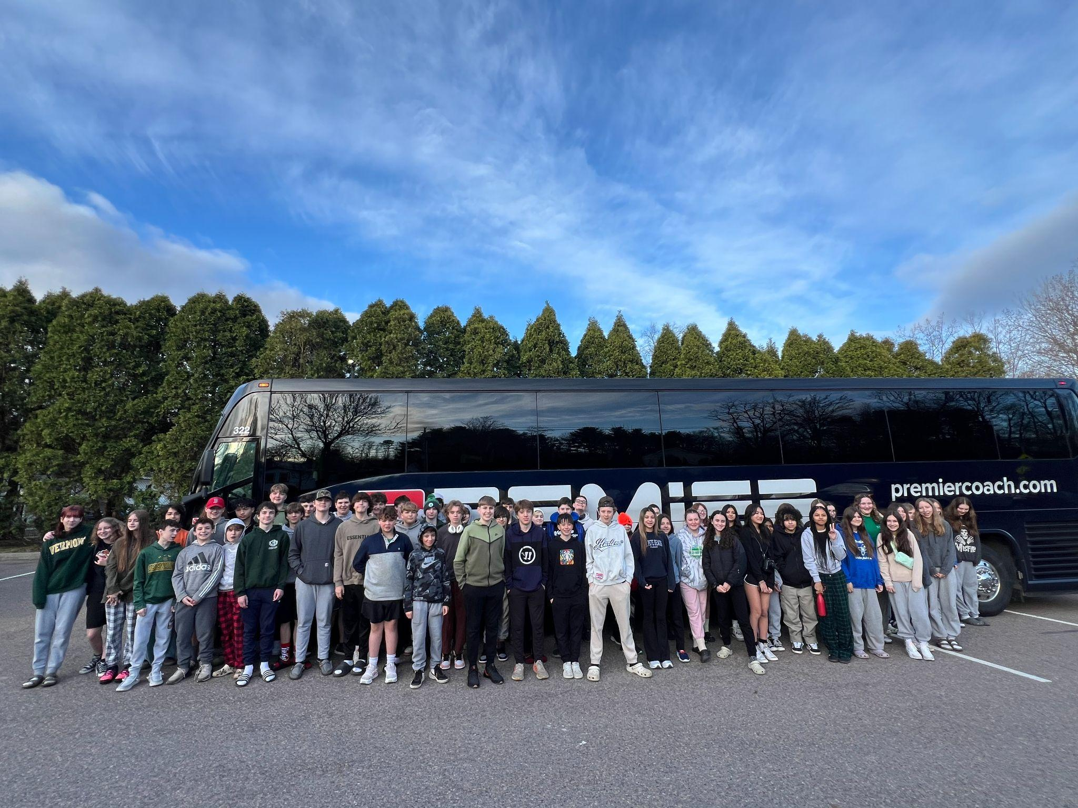
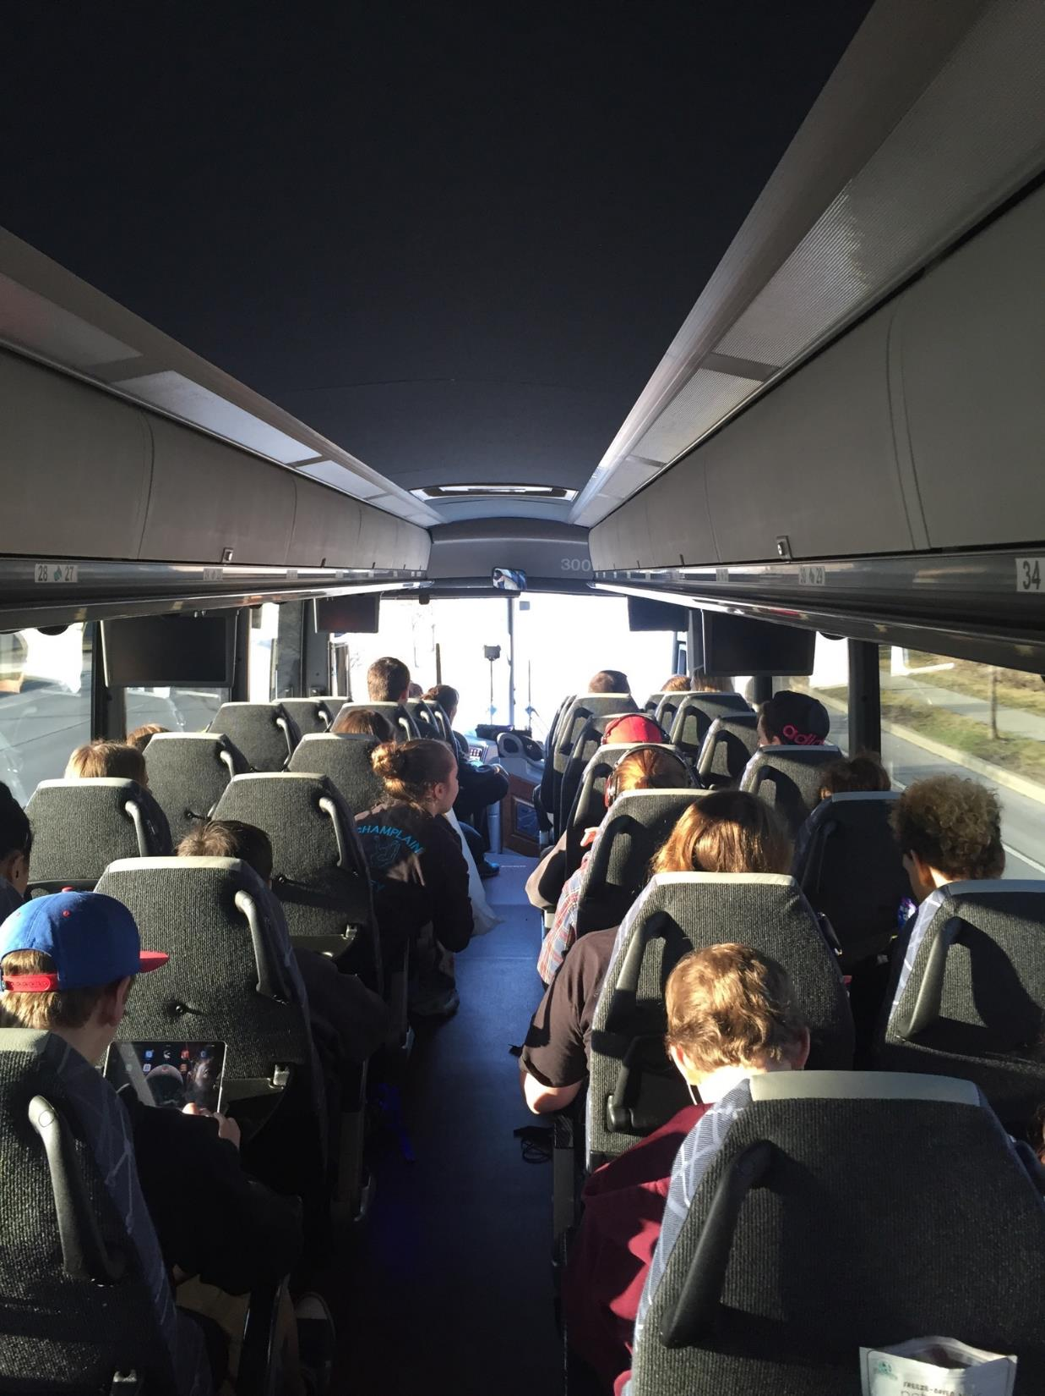
TRANSPORTATION
Provided by Premier Coach
56-passenger bus
Comfortable seats
Restroom
Wifi
DVD player
Outlets

Slide 7
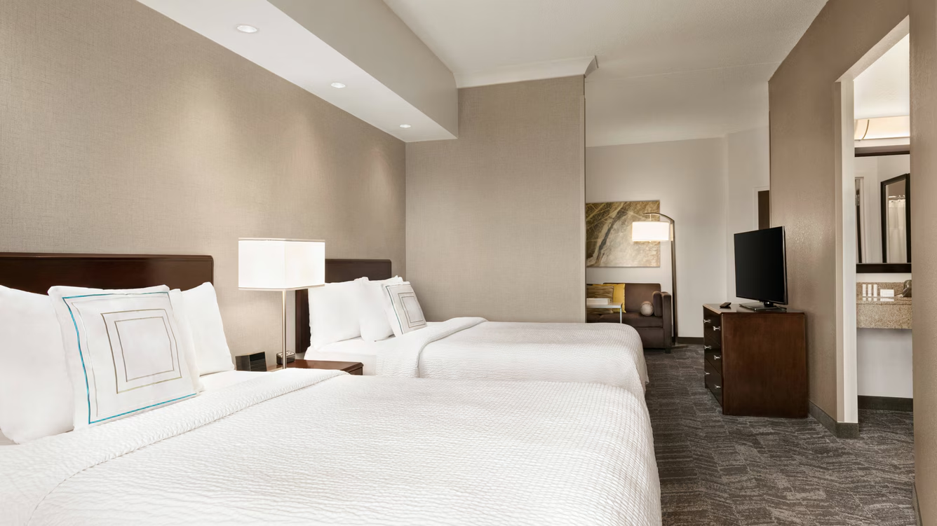
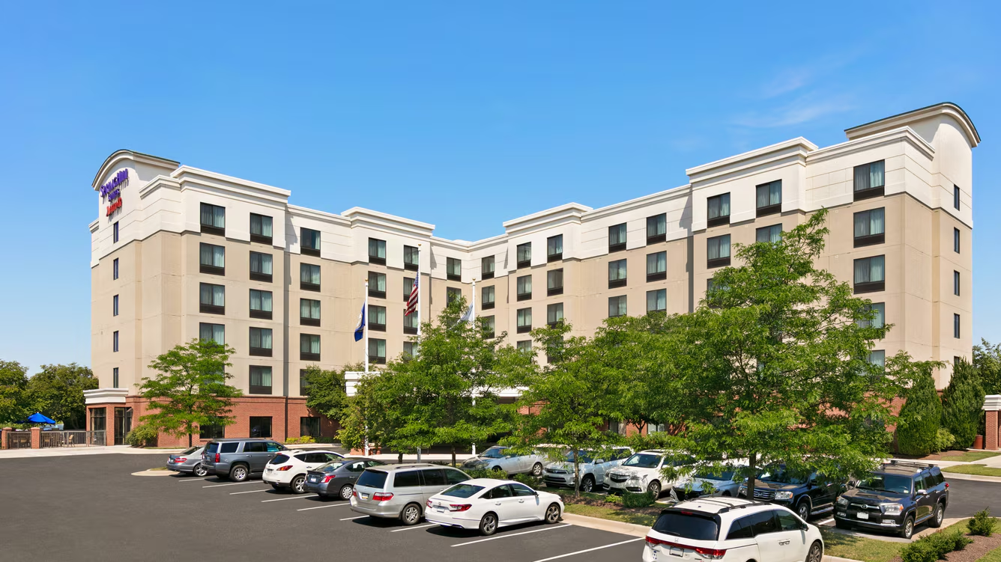
ACCOMMODATIONS
Springhill Suites in Sterling, VA
3-4 students/room with 2 double beds or king with pullout couch
25 miles from downtown DC
Complimentary hot breakfast daily
Indoor pool
Basketball court
Free wifi

Slide 8
DRAFT AGENDA
Note:
We will attempt to accomplish all of the following
There are many complicating factors that may impact our itinerary- tour availability, weather, etc.
We will release a final schedule just prior to departure –which will still be subject to change

Slide 9
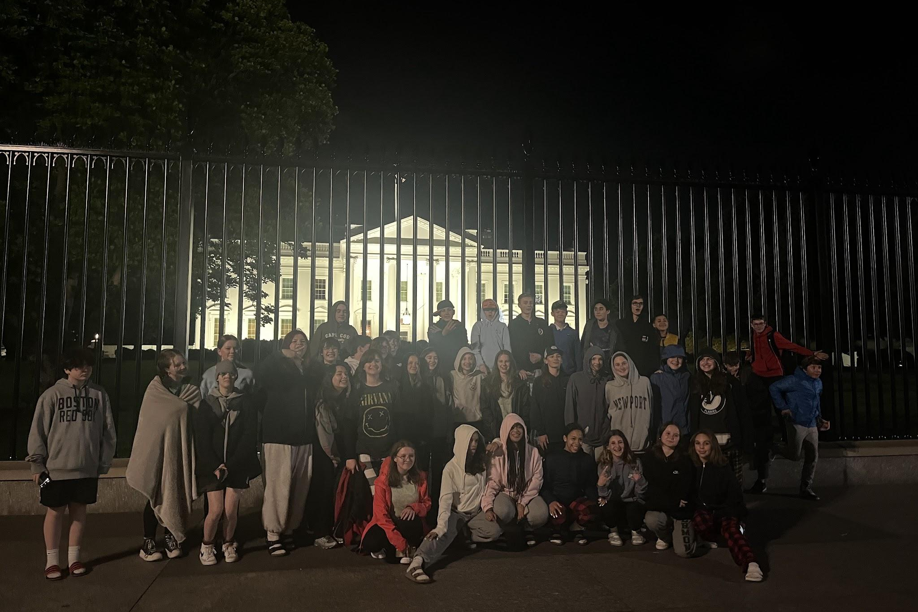
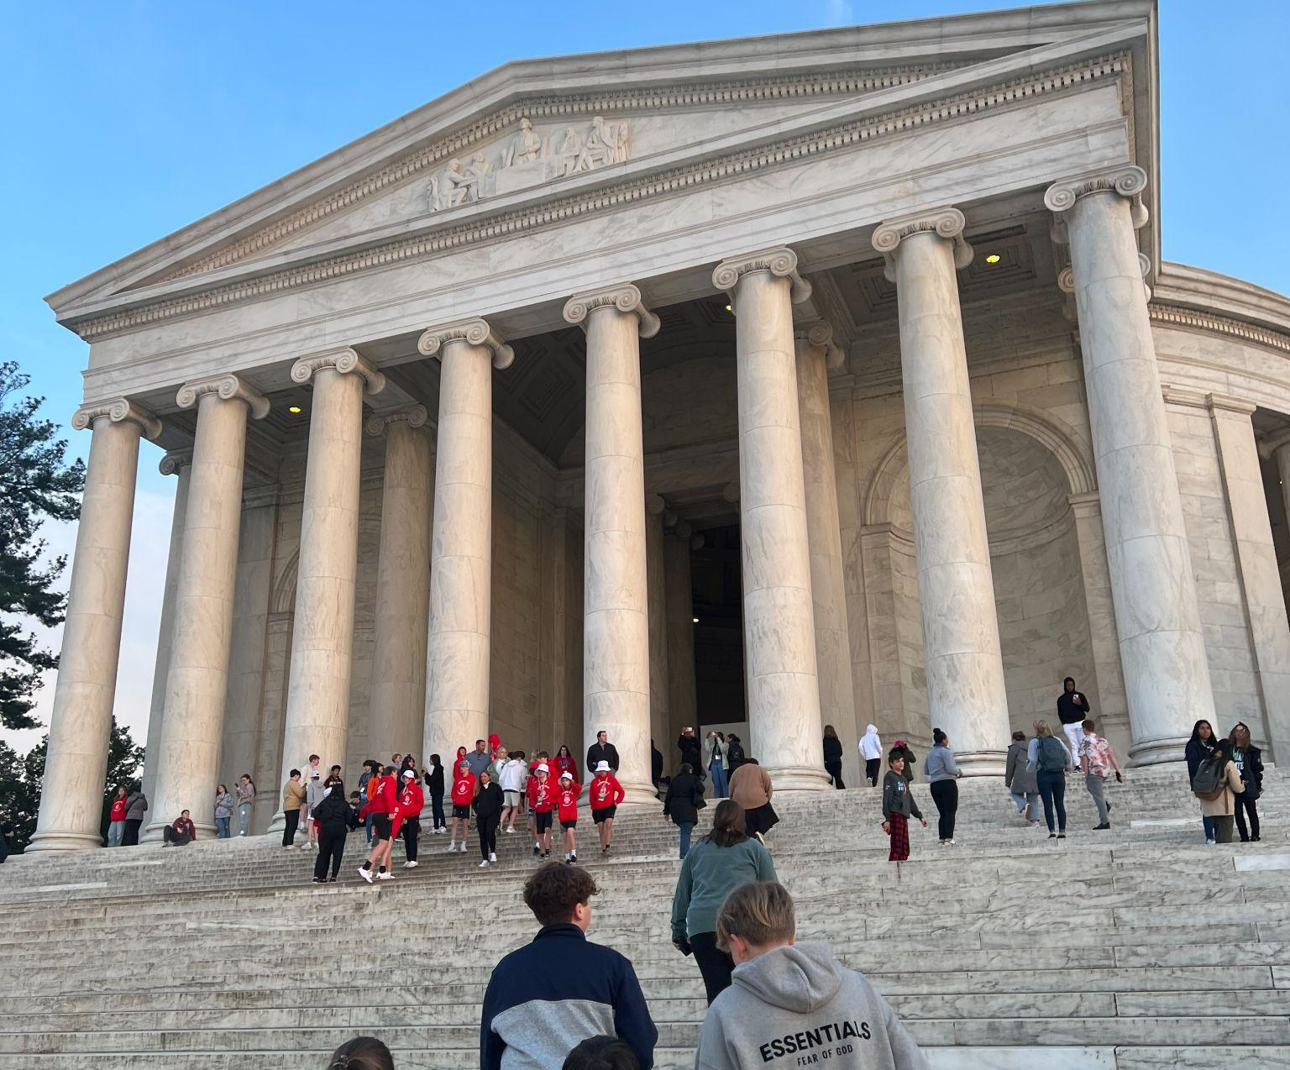
DAY 1:
Monday, APRIL 21
7am Depart Maple Street Recreation Center. Arrive by 6:45am.
Stop occasionally for restroom & stretch breaks
Bring a bagged lunch (or $ to buy lunch)
Dinner at Uno’s Pizzeria
DC Night Tour- stopping at Jefferson, Iwo Jima, Lincoln Memorial, and White House
11pm Check into hotel

Slide 10
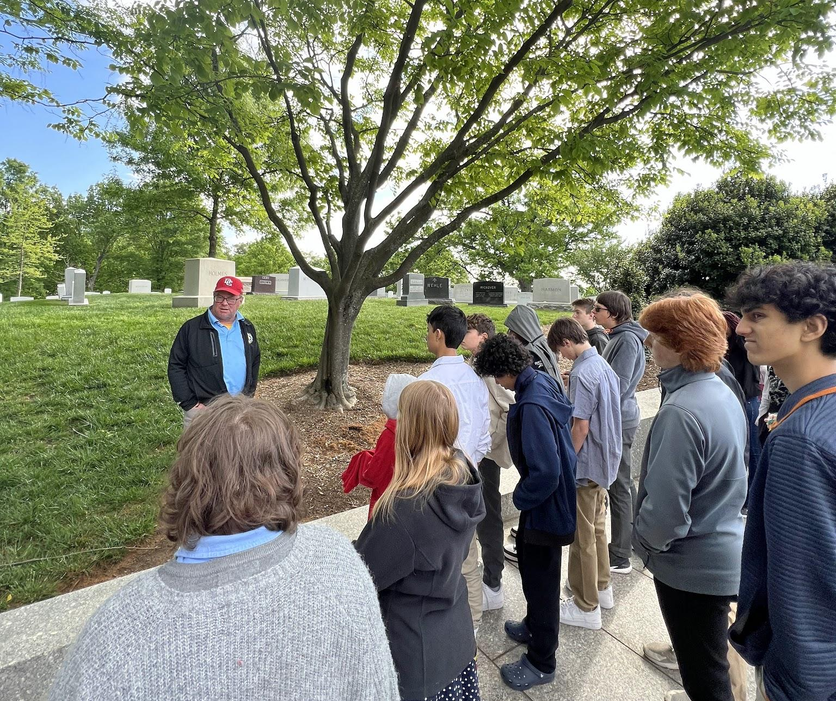
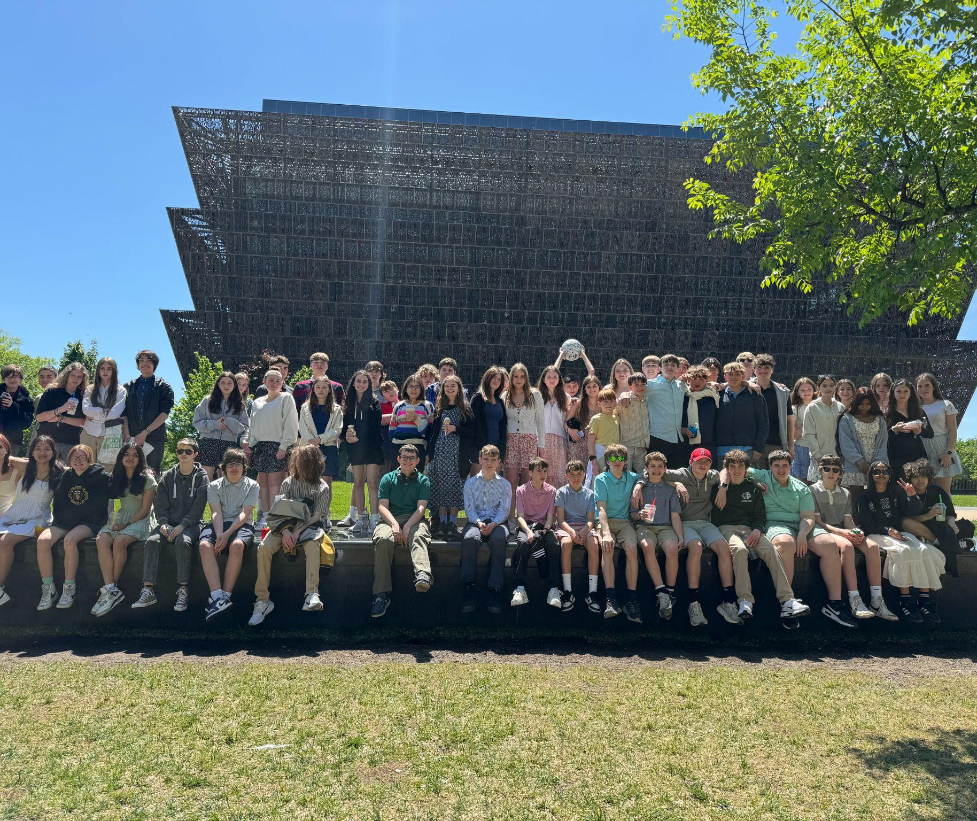
DAY 2: TUESDAY, APRIL 22
Breakfast at hotel
Arlington National Cemetery
400,000+ military veterans
Tomb of the Unknown Soldier & Changing of the Guard
JFK’s Eternal Flame
Pentagon Tour
17.5 miles of corridor & 23,000 employees
Lunch at Pentagon City Mall
Natural History Museum
Hope diamond, dinosaurs, ocean life, mammals, human origins, insect zoo
Holocaust Museum
Living memorial to persecution of 6,000,000 Jews by the Nazi’s
Paddle boats
Dinner at Crystal City Sports Pub

Slide 11
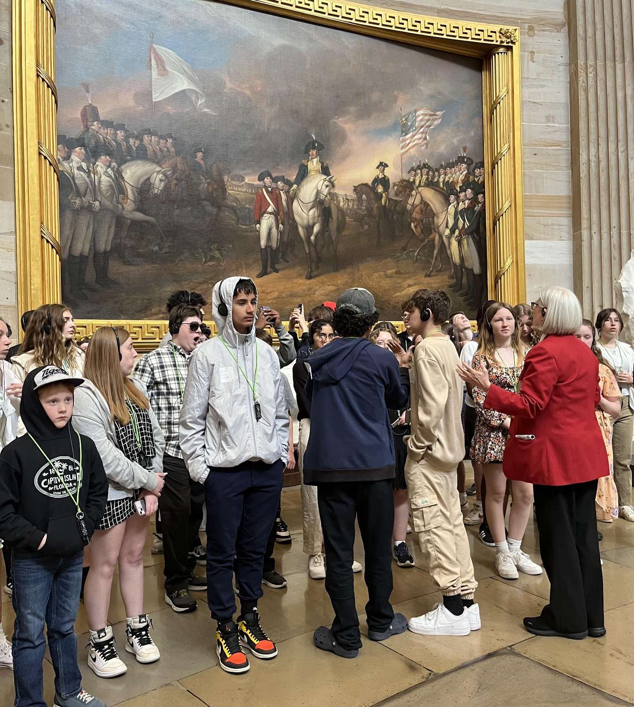
DAY 3: WEDNESDAY, APRIL 23
Breakfast at hotel
West Potomac Park- FDR & MLK Memorials
National Archives
Declaration of Independence, Constitution, Bill of Rights
Bureau of Engraving and Printing
Lunch at Food Trucks
US Capitol Tour
House/Senate Galleries
Botanical Gardens
Dinner in Sterling, VA (Olive Garden or Sweetwater Tavern)

Slide 12
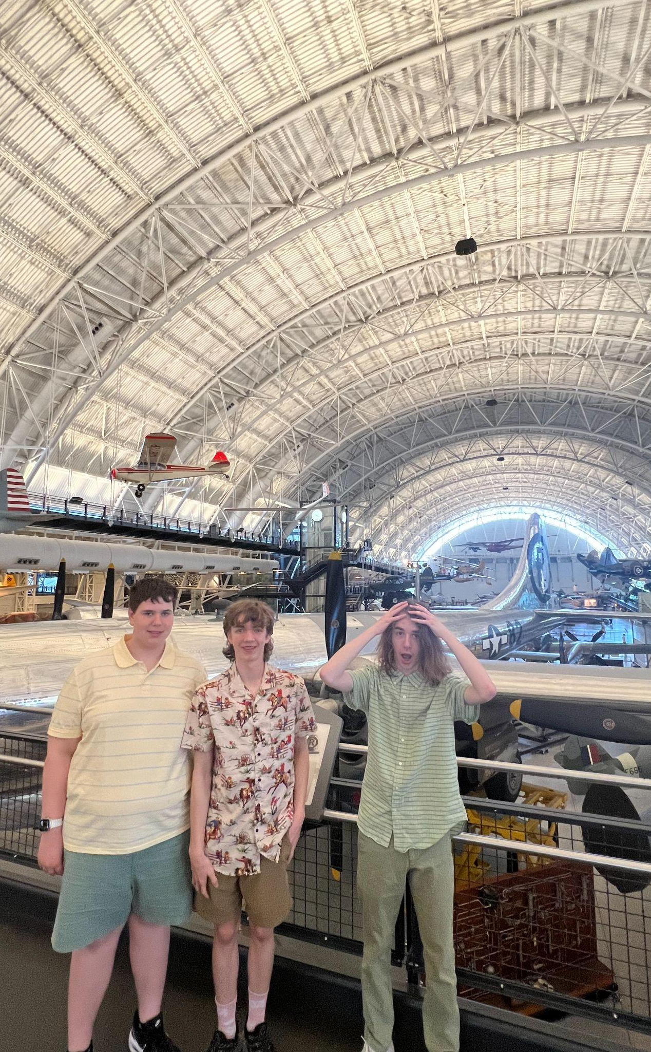
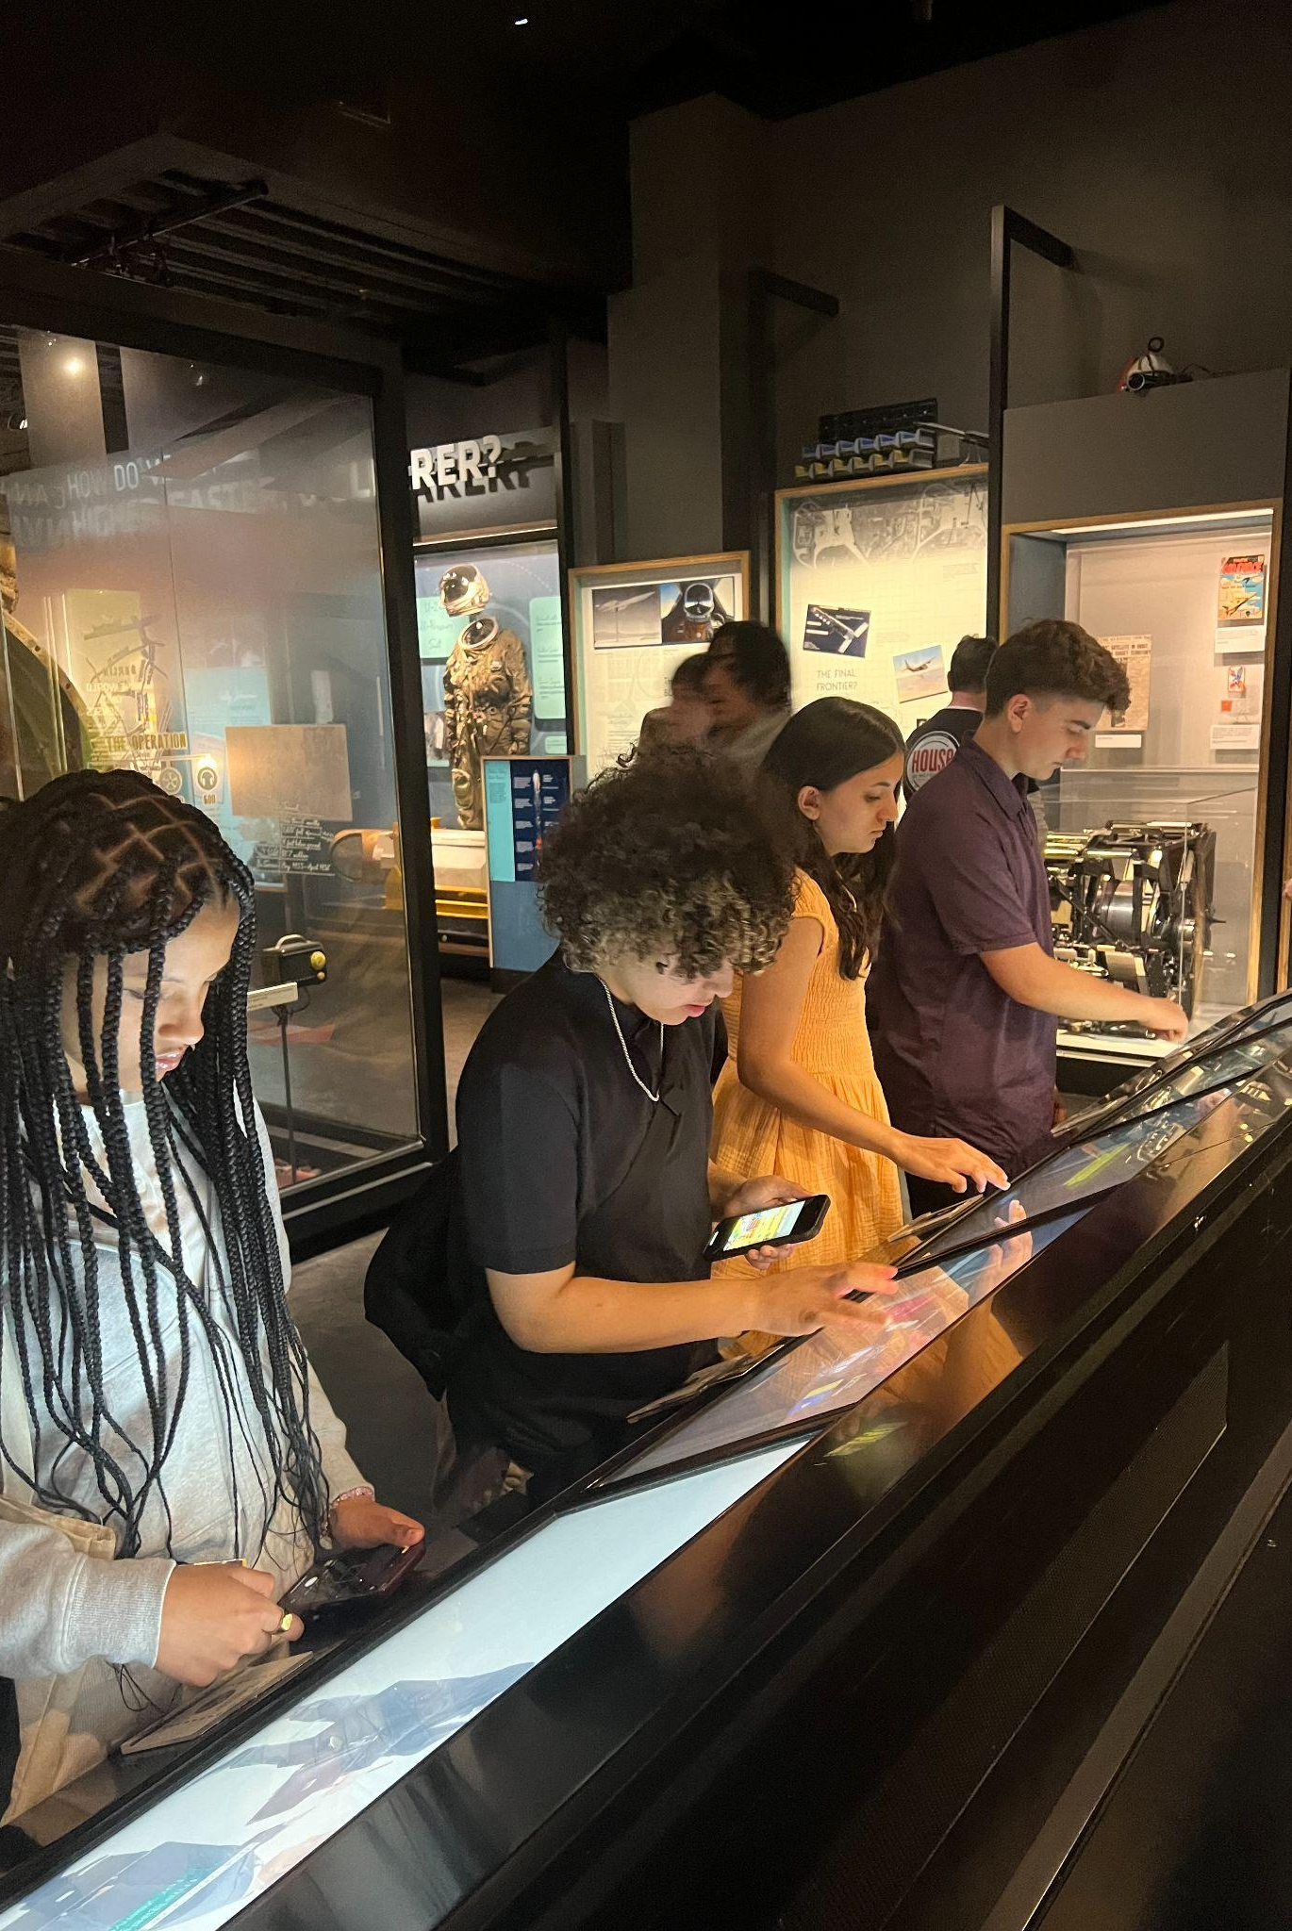
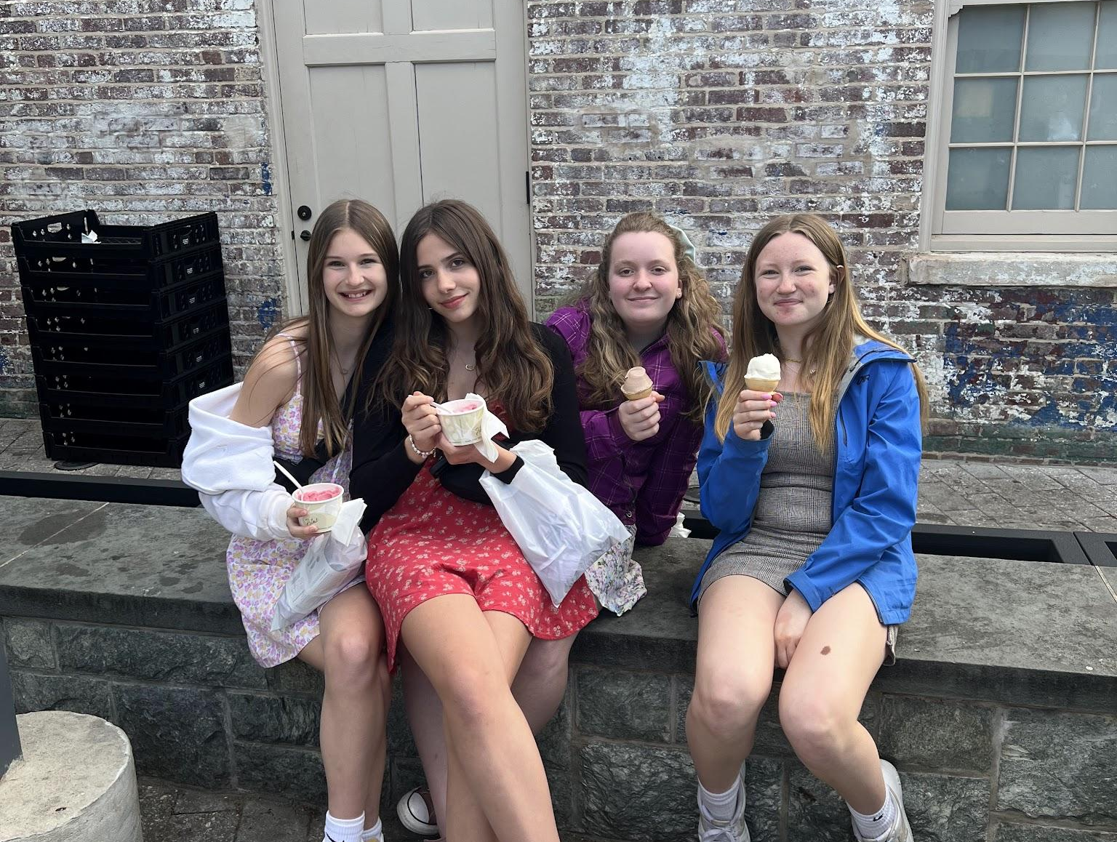
DAY 4: THURSDAY, APRIL 24
Breakfast at hotel
Udvar Hazy Air and Space Museum
Thousands of aircraft, including:
Space Shuttle Discovery (39 space missions),Enola Gay (dropped 1st atomic bomb), Lockheed Blackbird (fastest jet propelled aircraft)
Lunch at Panera Bread
International Spy Museum
American History Museum
Dorothy’s ruby slippers, original American flag, Lincoln’s top hat
Shear Madness Production at Kennedy Center
Dinner at Kennedy Center

Slide 13
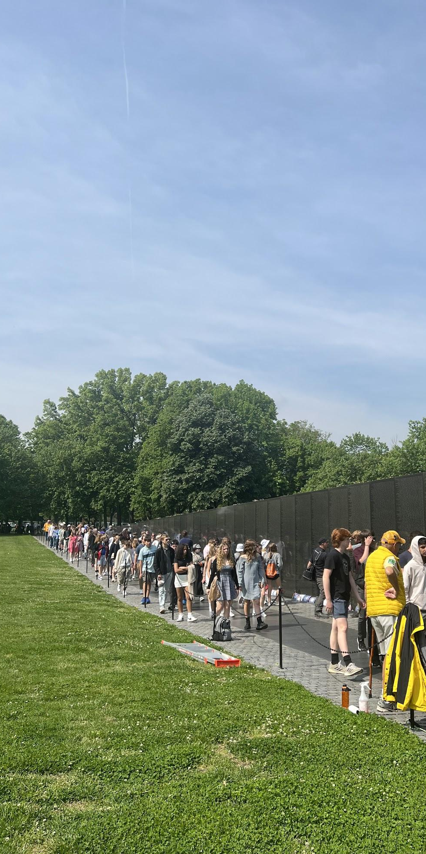
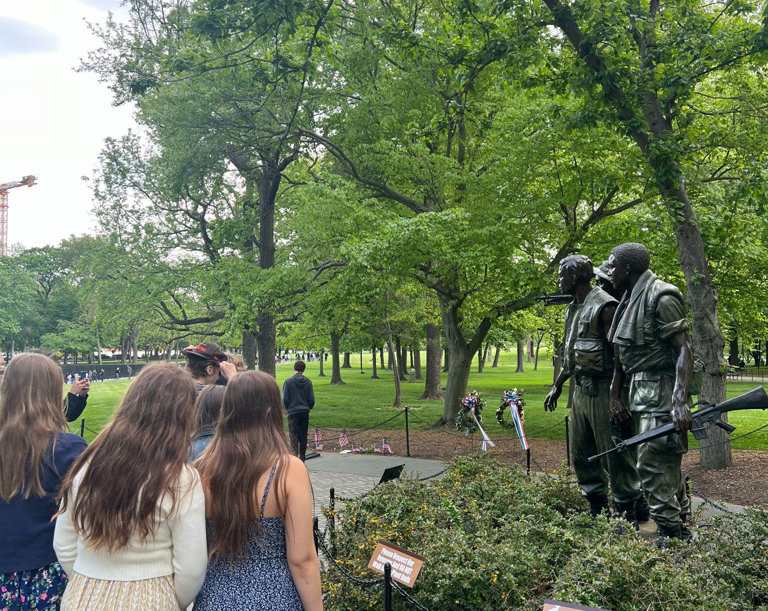
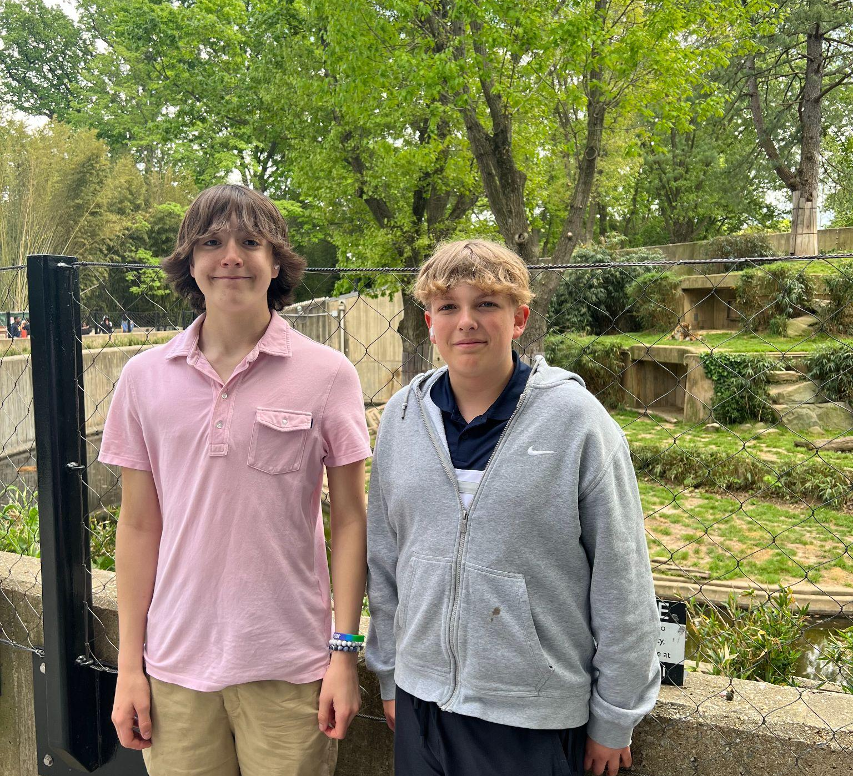
DAY 5: FRIDAY, APRIL 25
Breakfast at hotel
Load bags onto bus
Lincoln, WWII, Korean, Vietnam Memorials and Washington Monument
African American History & Culture Museum
Rosa Parks’ dress, Louis Armstrong’s trumpet, Woolworth’s lunch counter,
Lunch at Food Trucks
National Zoo
Elephants, pandas, apes, insects, reptiles, lions, tigers
3:30pm Depart DC for Vermont
Arrive back at EJRP at 1:30am on Friday

Slide 14
FINANCIALS
$925 if registered by October 20
$975 from October 21-November 15
$1025 after November 16 until trip is filled
$200 non-refundable deposit due at registration
50% of balance due by December 2
Remaining balance due by February 3
Non-refundable unless we are able to fill your spot
Not included in price: Travel Insurance, Lunch on Sunday, Optional Shopping, Snacks, Souvenirs
Limited partial scholarships are available, form is on our website

Slide 15
REGISTRATION
Registration will open Thursday September 19 at 9AM
Complete online registration at our website (www.ejrp.org), or call 802-878-1375, or come by the office
Note: Minimum of 40 students needed for trip. Max of 48 students on the first bus. After 48 registrations we will begin a waitlist (no fee). Need 80 registrations for a second bus.

Slide 16
FUNDRAISING
Opportunities are up to you!
Here are some ideas:
Ask neighbors and family members if they need help with raking leaves, washing cars, mowing lawns, shoveling snow, babysitting, carrying groceries, or dog walking
Put money aside from birthdays, holidays, or allowances
Set up a yard sale, bake sale, or lemonade stand
Start a change jar

Slide 17
MISCELLANEOUS
We will be dressing up each day.
Is: khaki/dress pants, dresses, skirts, collared shirts
Is not: jeans, shorts, sweatpants, joggers, shirts w/out a collar, tank tops
We will take roommate requests and assign roommates prior to the trip, however, not all requests can be honored.
We will assign chaperone groups for you to have a primary chaperone to check in with throughout each day.
We will be walking…..a lot! Wearing comfortable footwear is important, along with being able to walk many miles a day for multiple days in a row.
We will have a pre-trip meeting in April to review plans and further details.

Slide 18
STUDENT CONDUCT
Choices should be:
Respectful
Responsible
Caring
Honest
Safe
Legal
Listen and follow instructions from chaperones, bus driver, tour guides, security, hotel management, etc.
No exiting rooms between lights out and breakfast
Call chaperone in case of emergency
Be flexible- plans can change due to weather or tour availability

Slide 19
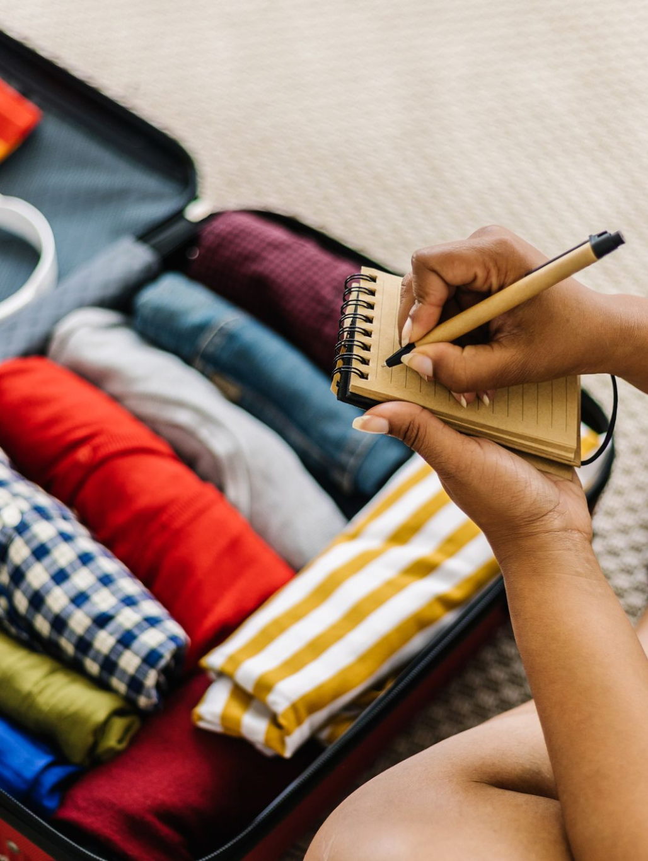
WHAT TO BRING
Bagged lunch for Sunday (or $)
Comfortable clothes for the bus ride
Four business casual outfits
Comfortable walking shoes
Jacket/sweatshirt
Umbrella or raincoat
Pajamas
Undergarments
Toiletries
Any needed medications
Small bag to bring with you each day
Reusable water bottle

Slide 20
WHAT TO BRING (OPTIONAL)
Bathing suit and sandals for hotel indoor pool
Entertainment for bus ride and hotel
Cell phone and charger
Camera and batteries/charger
Sunglasses, hat, sunscreen
Any snacks you may want (there are refrigerators in rooms)
Spending money
You are responsible for bringing, carrying, and securing
the items you will need for the duration of the trip!

Slide 21
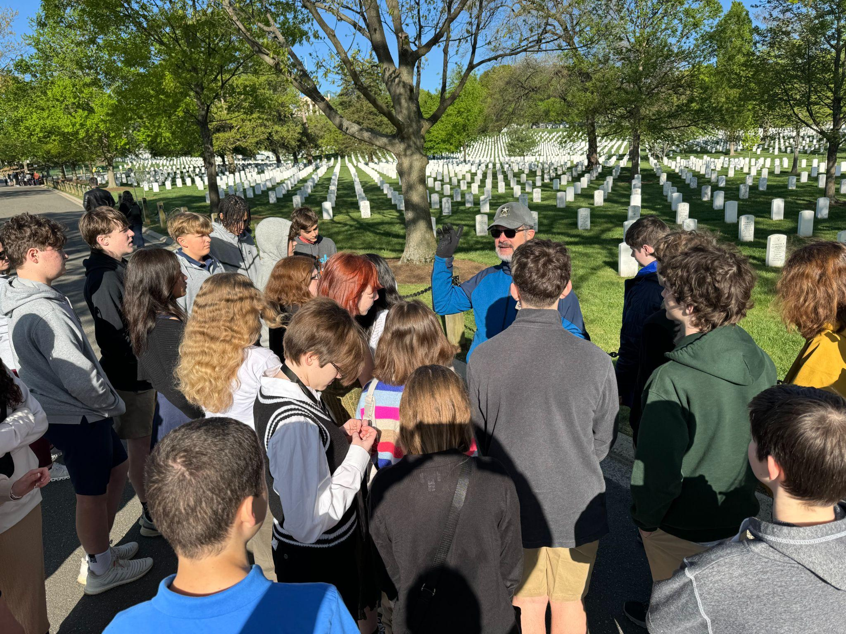
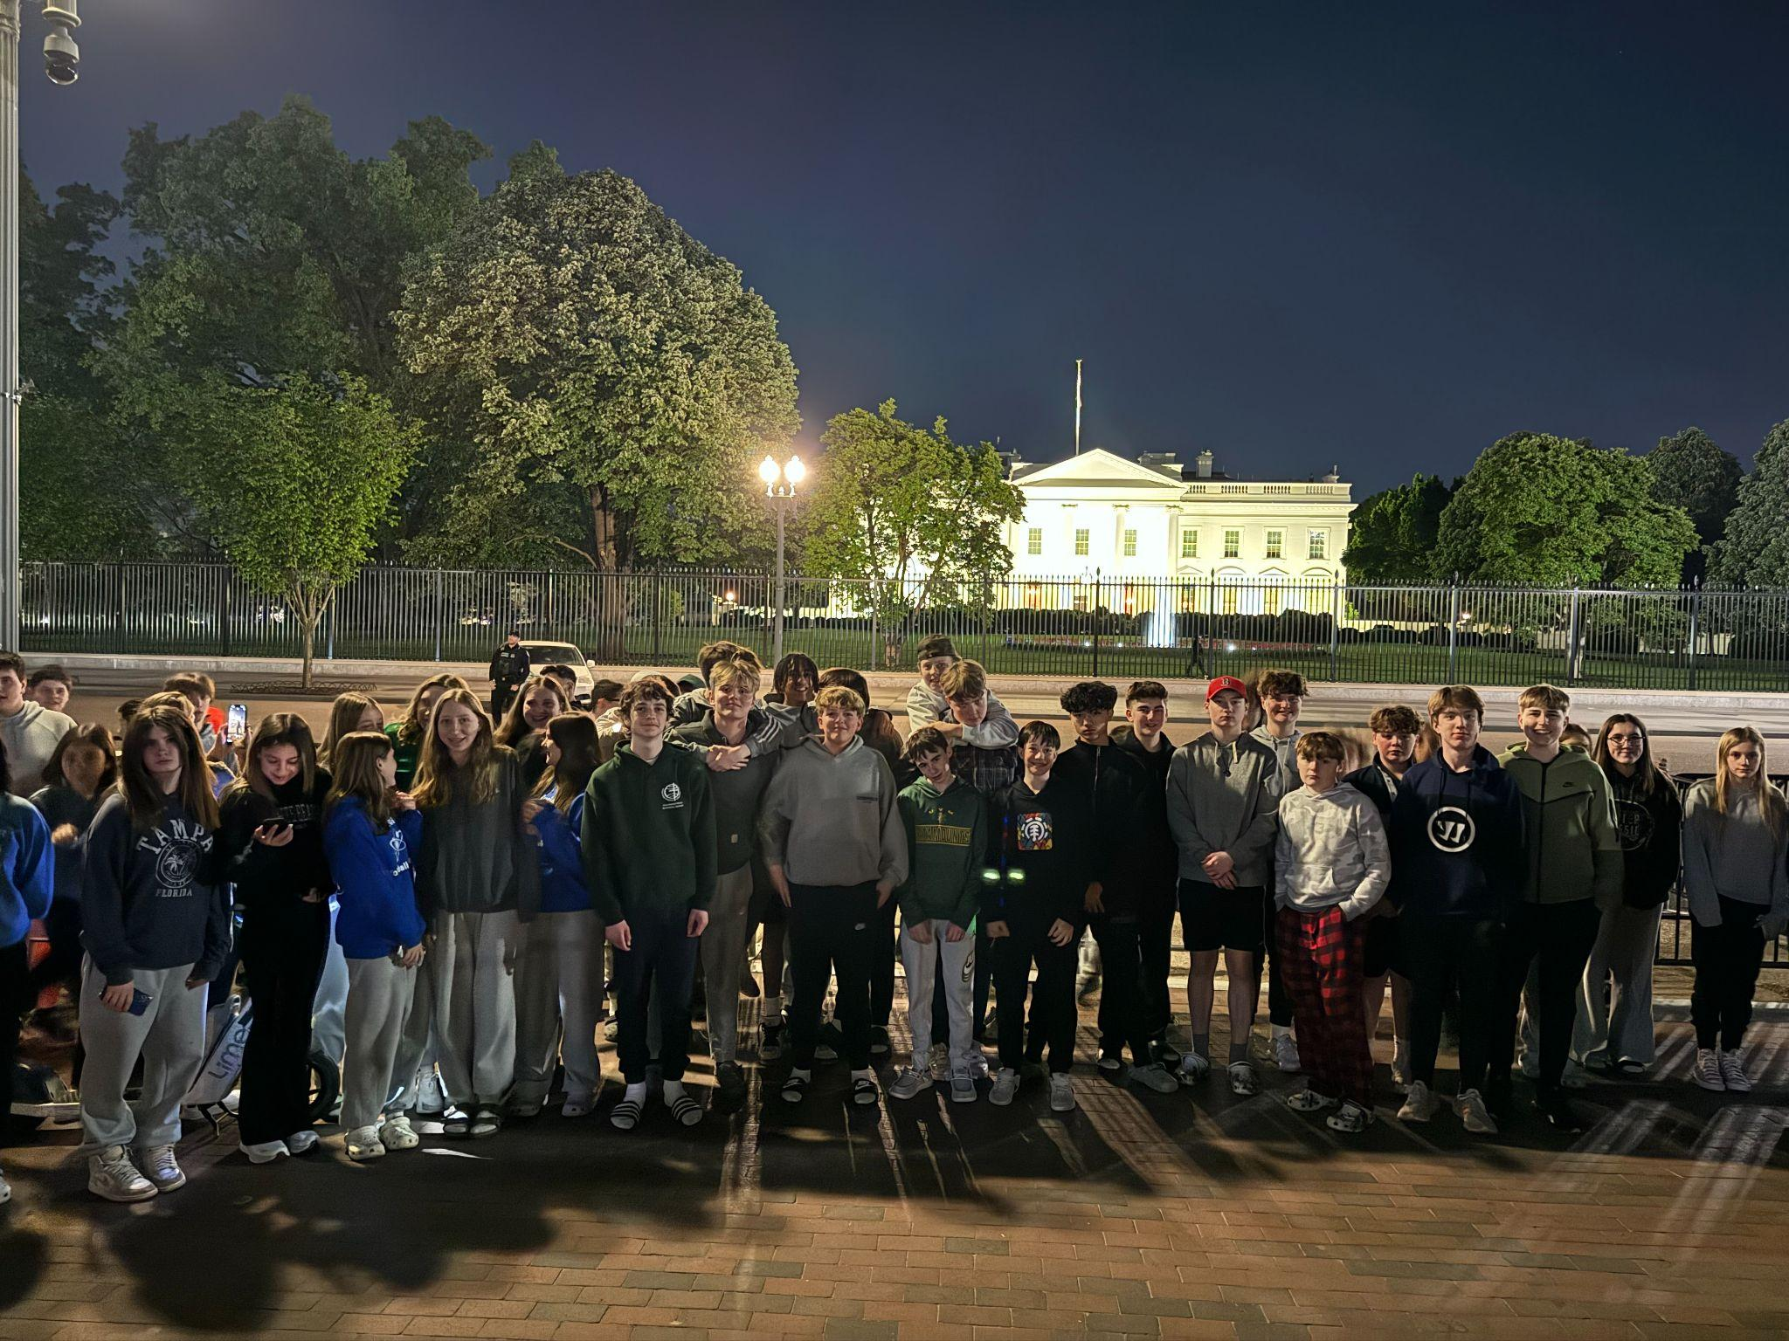
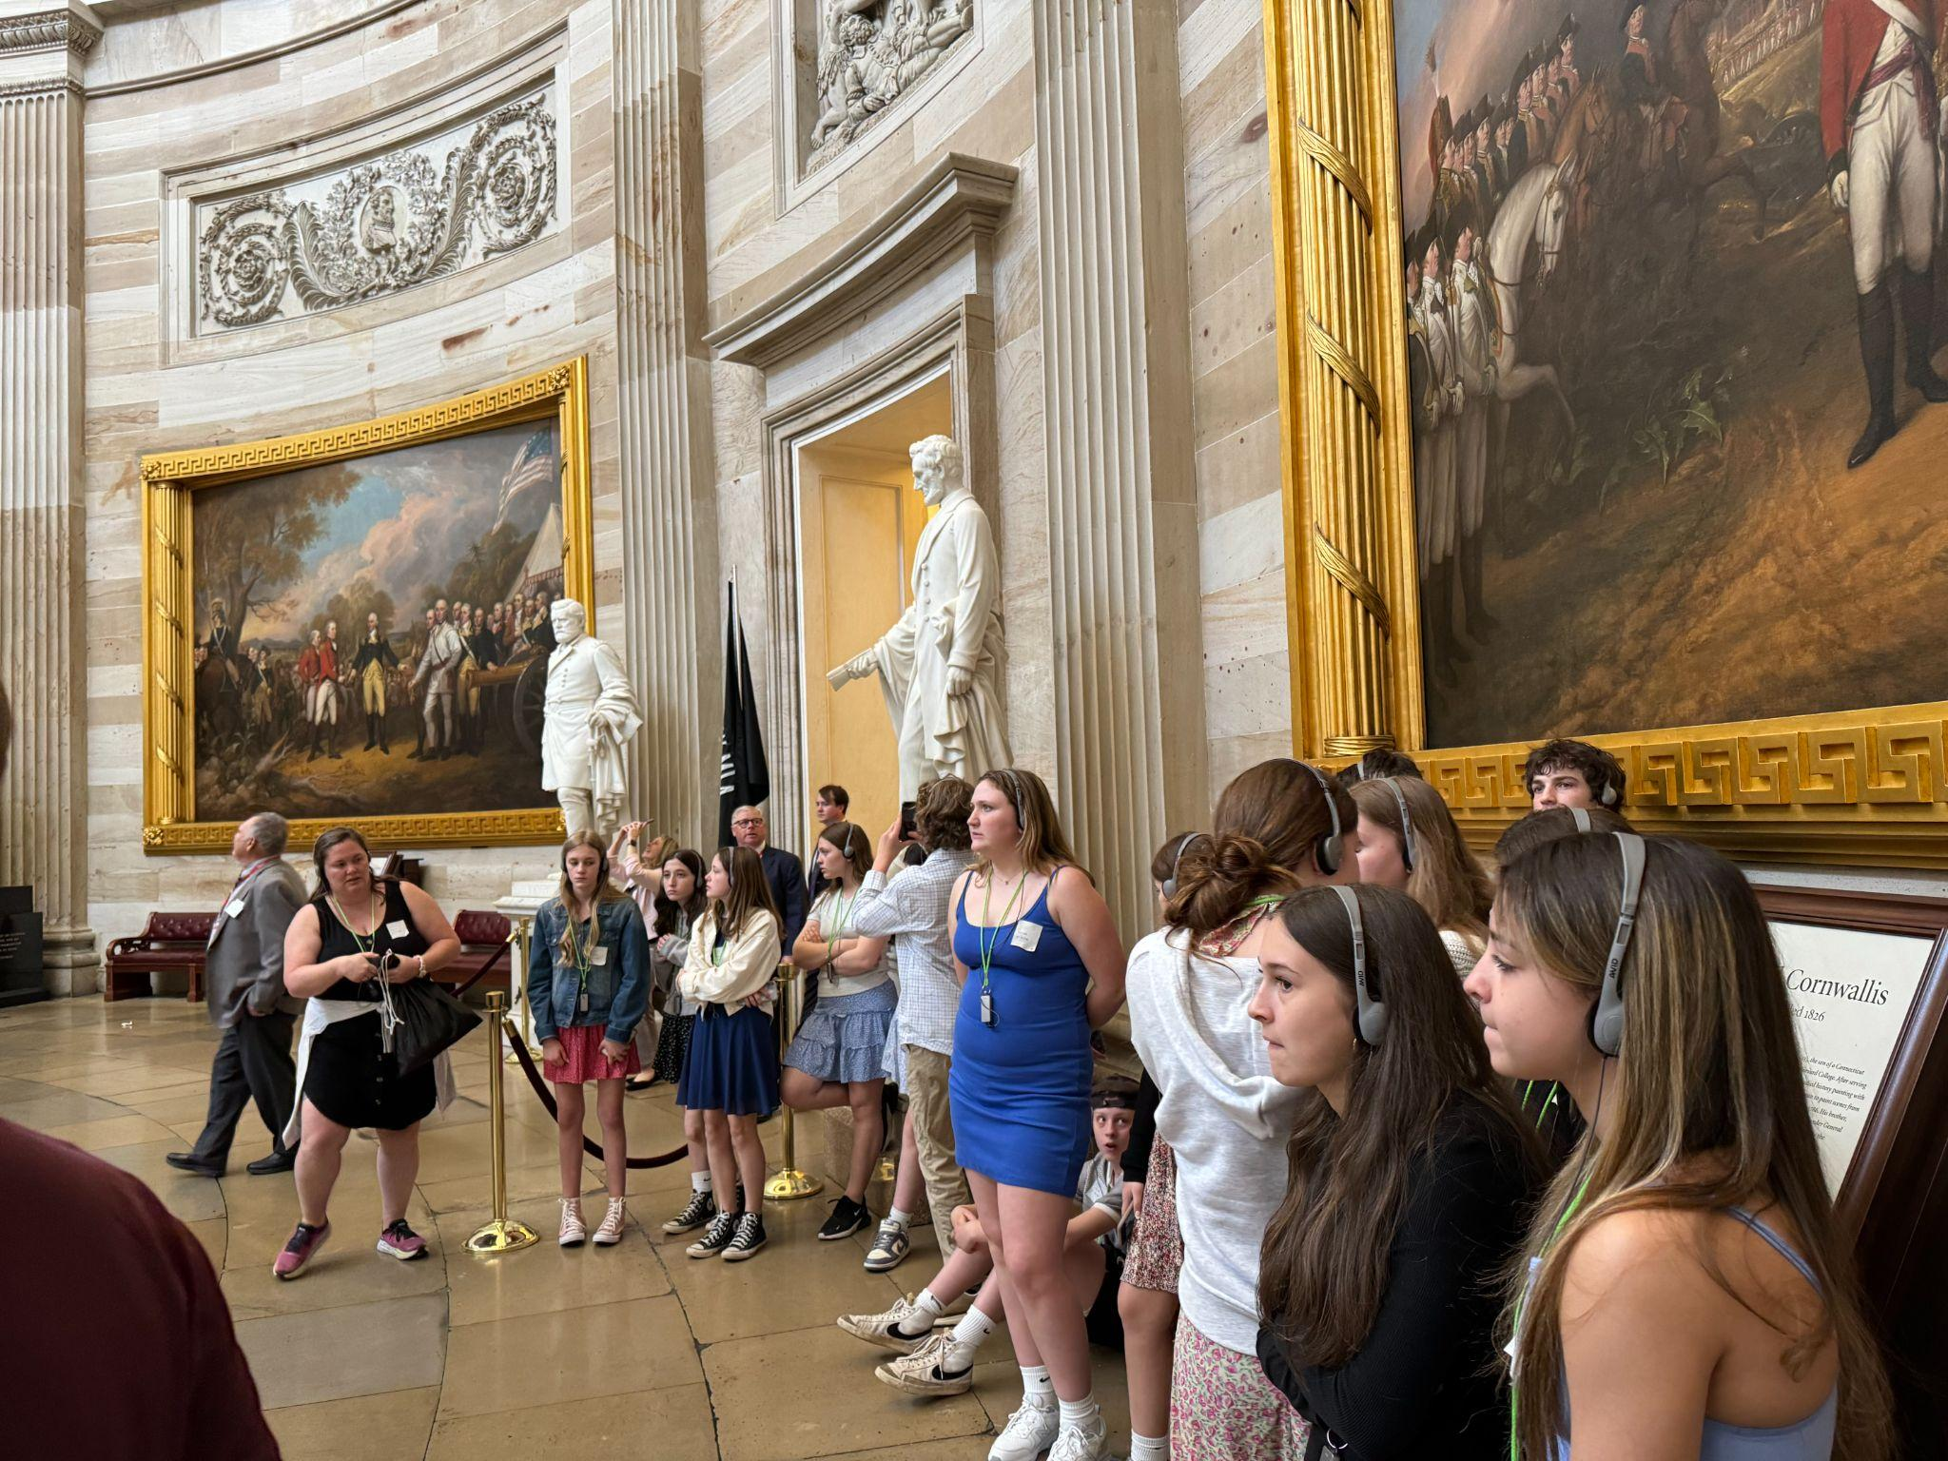
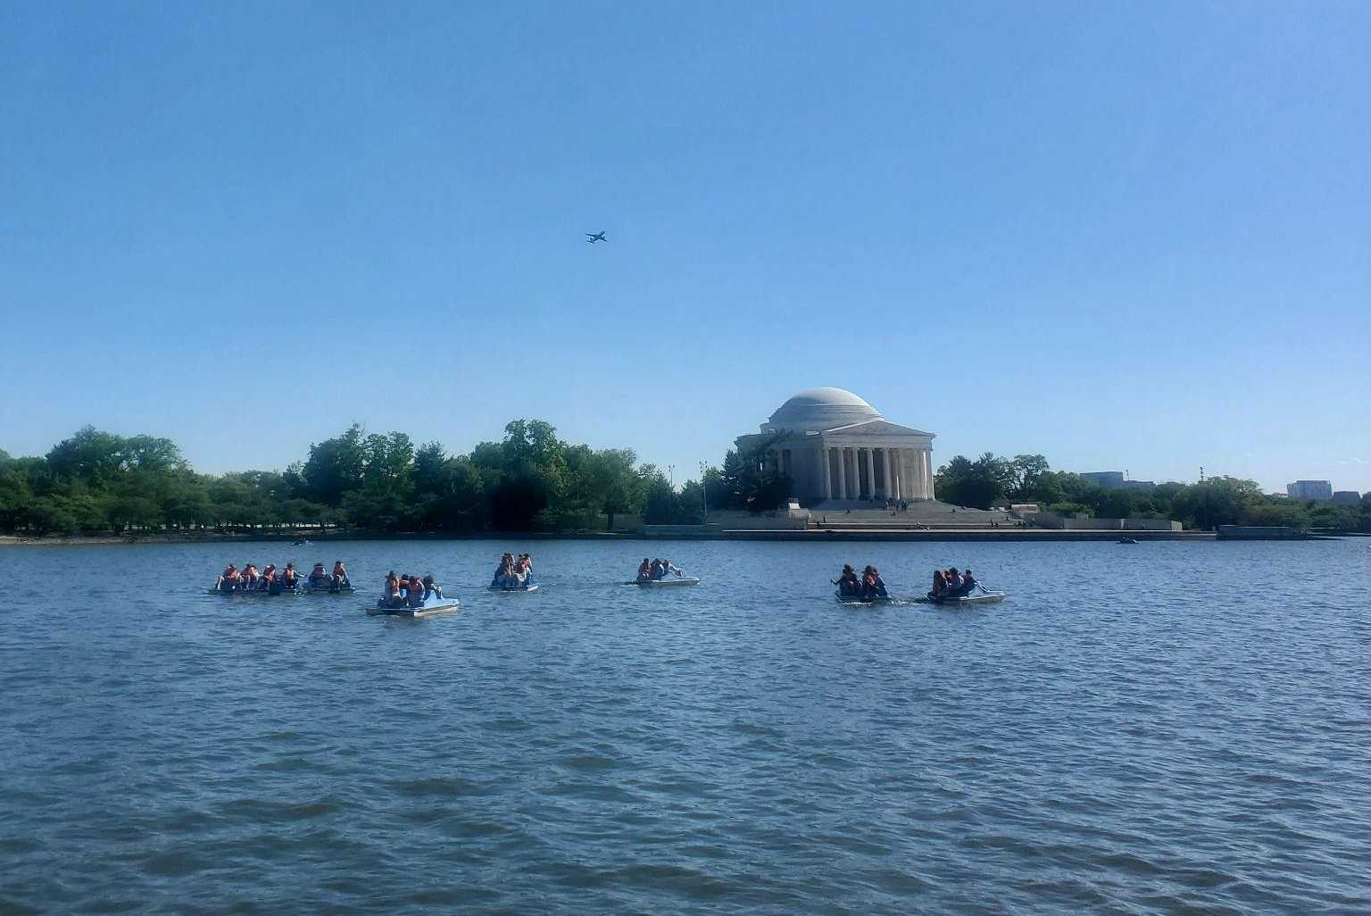
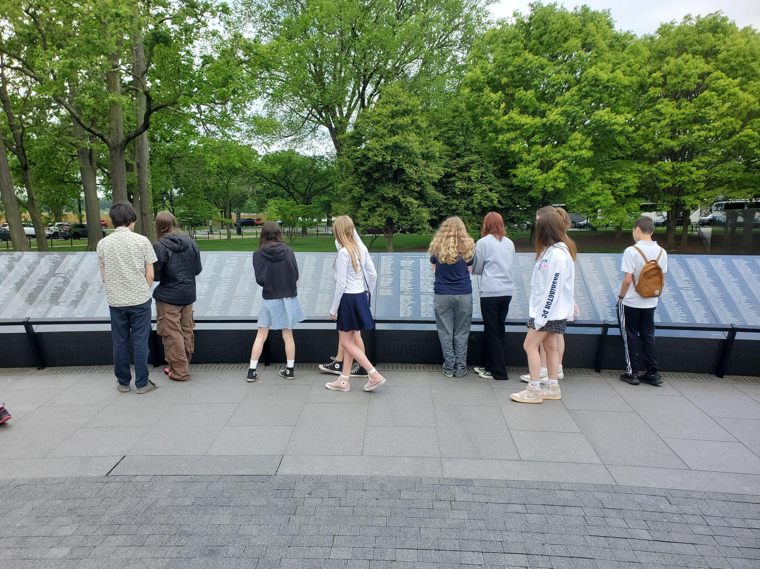
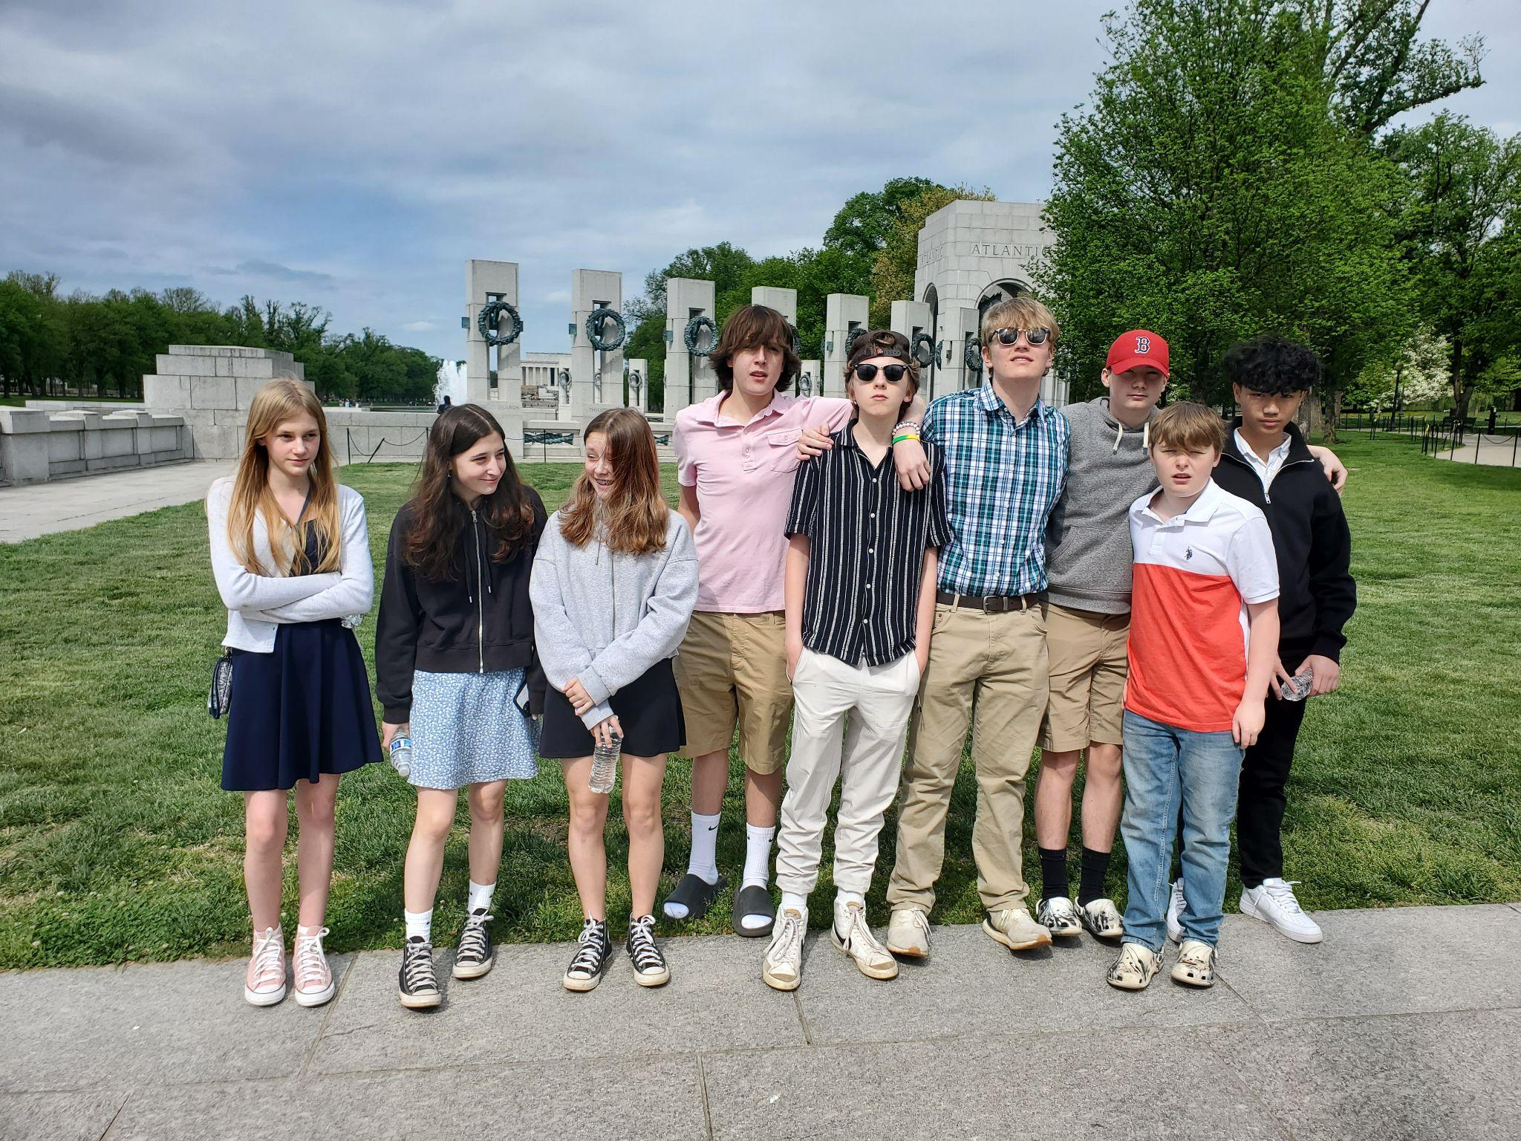
QUESTIONS?

